Slide 1
Jermyn Borough Council Meeting
6/17/21

Slide 2
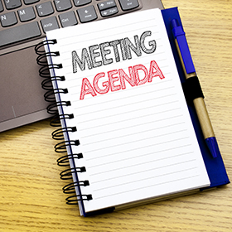
Meeting Agenda
Call to Order
Pledge of Allegiance
Roll Call
Previous Meeting Minutes
Treasurer’s Report/Bills Payable
Correspondence
Public Comment
Professional Reports
Committee Reports
Borough Manager Report
R&L Carriers Land Deal
Dwight Ave Paving
New Business
Adjournment

Slide 3
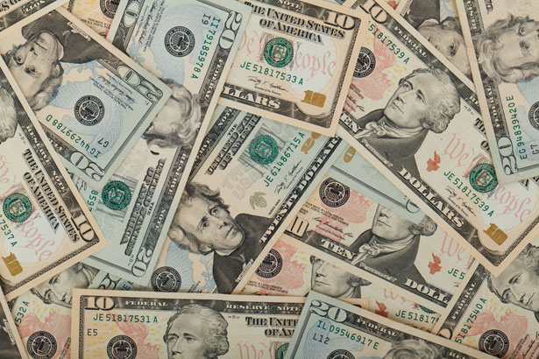
Treasurer’s report
6/17/21
ASSETS
Capital Reserve - DPW 10,398.35
Capital Reserve - Police 4,326.82
Crime Watch Fund 755.44
General Fund - Community 312,990.00
General Fund - FNB 2,808.07
Holiday Lights Fund 516.14

Slide 4
Treasurer’s report
6/17/21
ASSETS
Investment - General Fund 1,001.53
Investment - Liquid Fuels 33,814.33
Investment - Paving Fund 1,011.89
Investment - Recycling 5,003.47
Investment - Refuse 2,600.25
Liquid Fuels - FNB 59,621.03
Petty Cash 151.42
Recreations Fund 13,591.25
Recycling - Community 7,814.58
Refuse Checking - FNB 136,908.70
Total Checking/Savings 593,313.27

Slide 5
Treasurer’s report
Accounts Payable 52,145.40

Slide 6
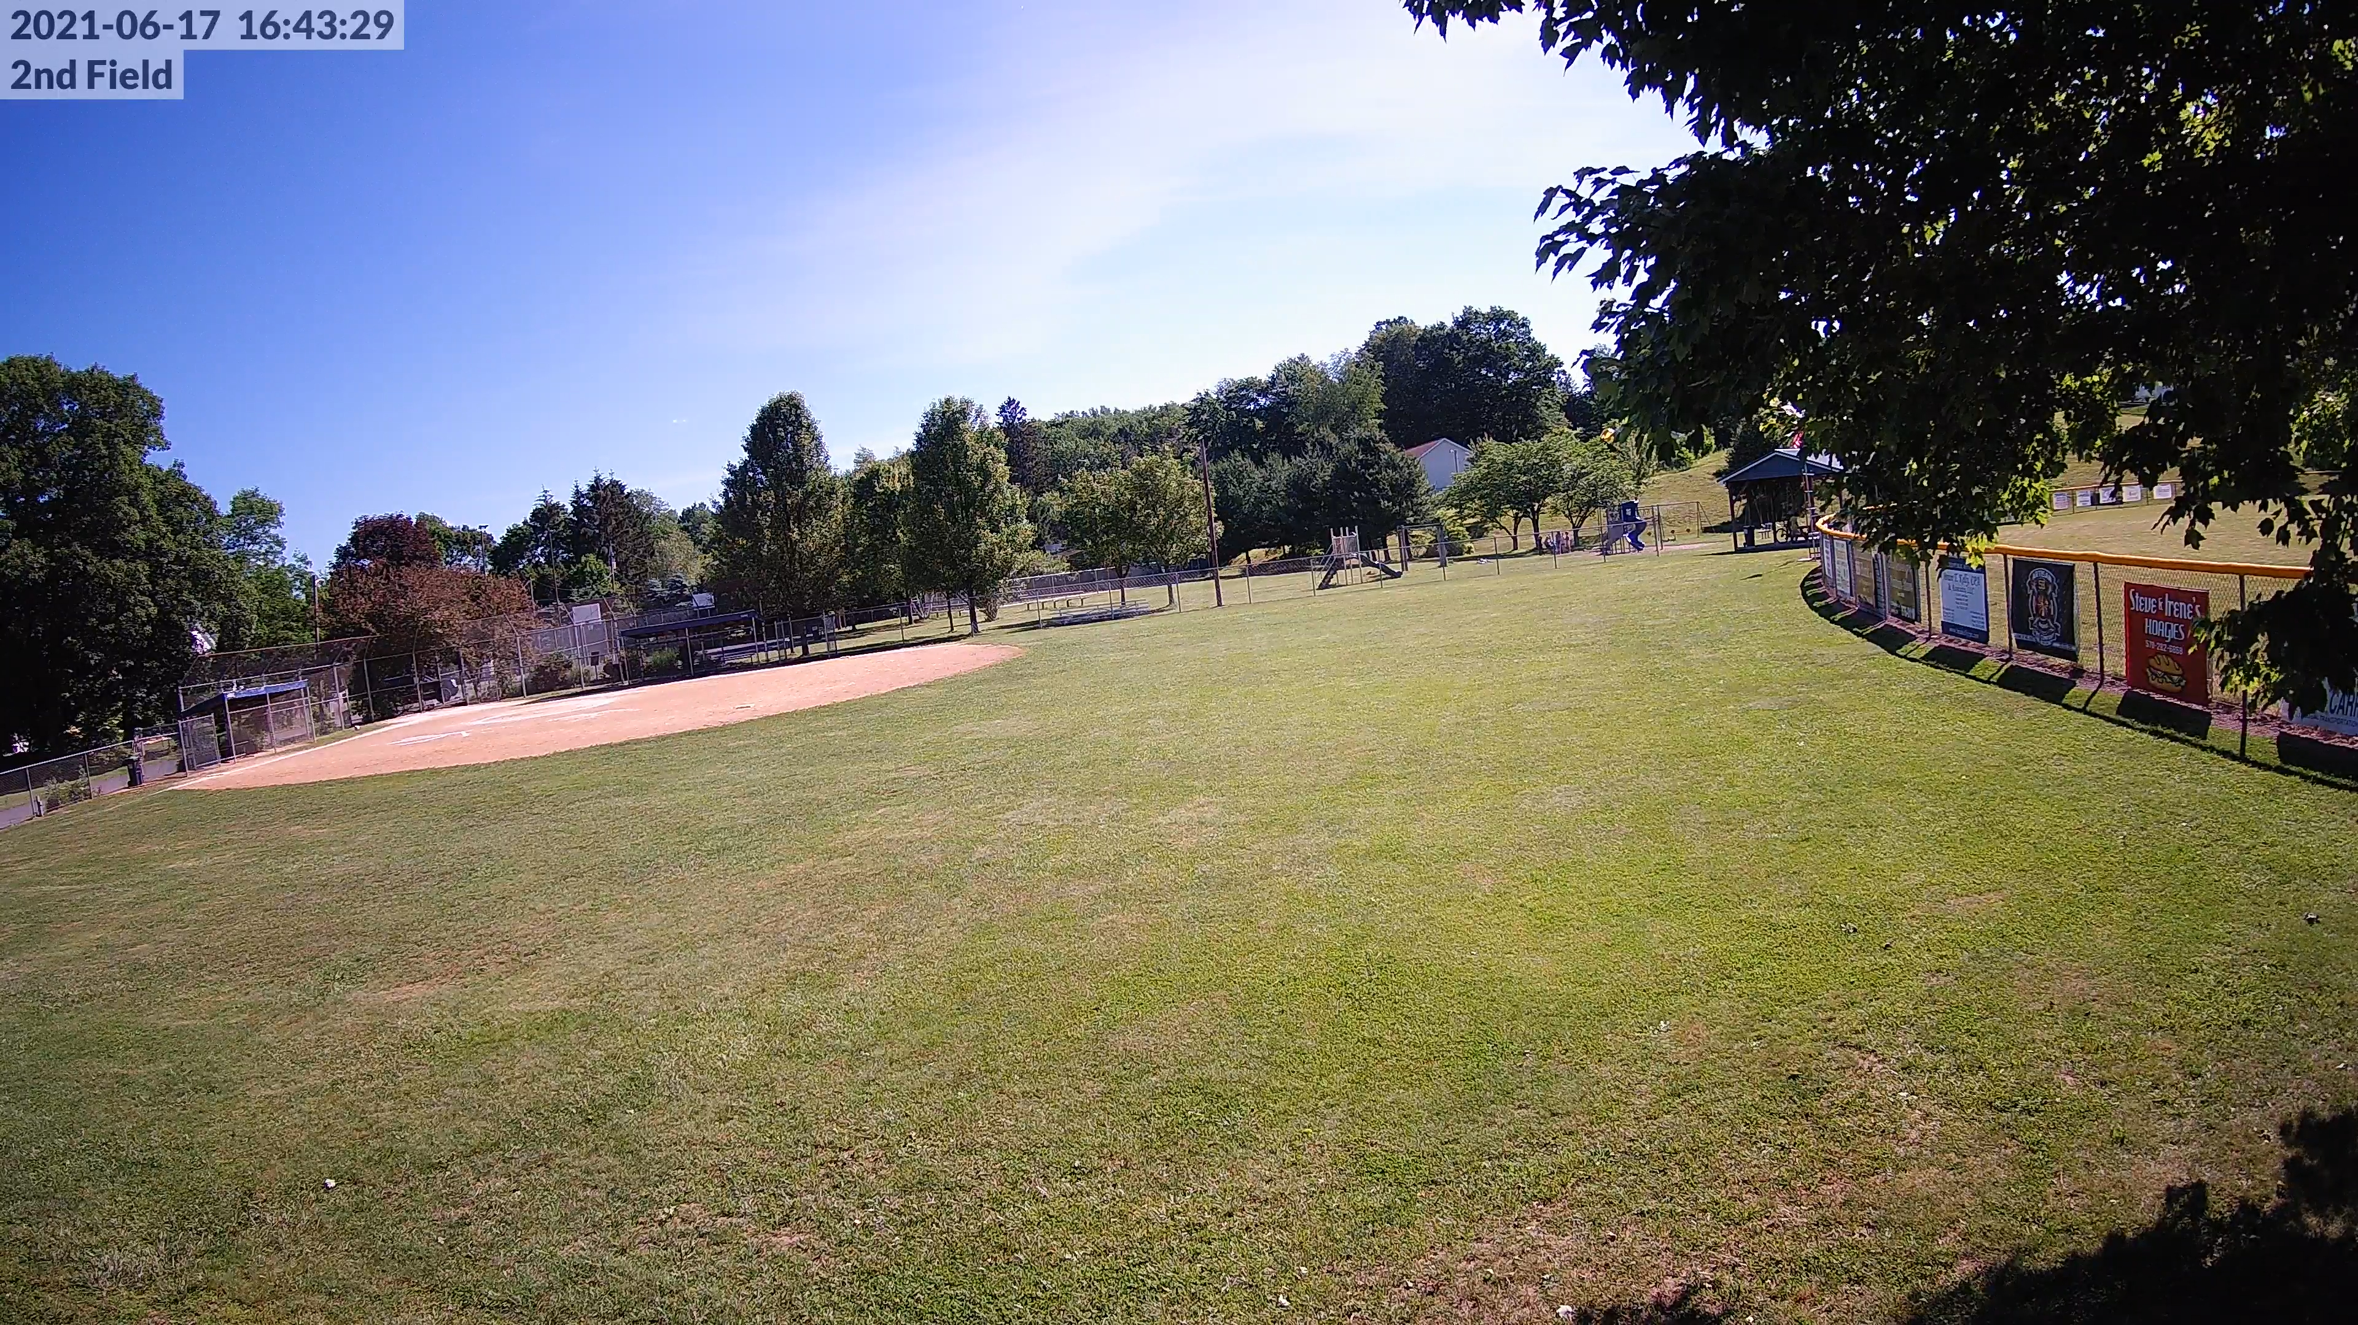

Slide 7
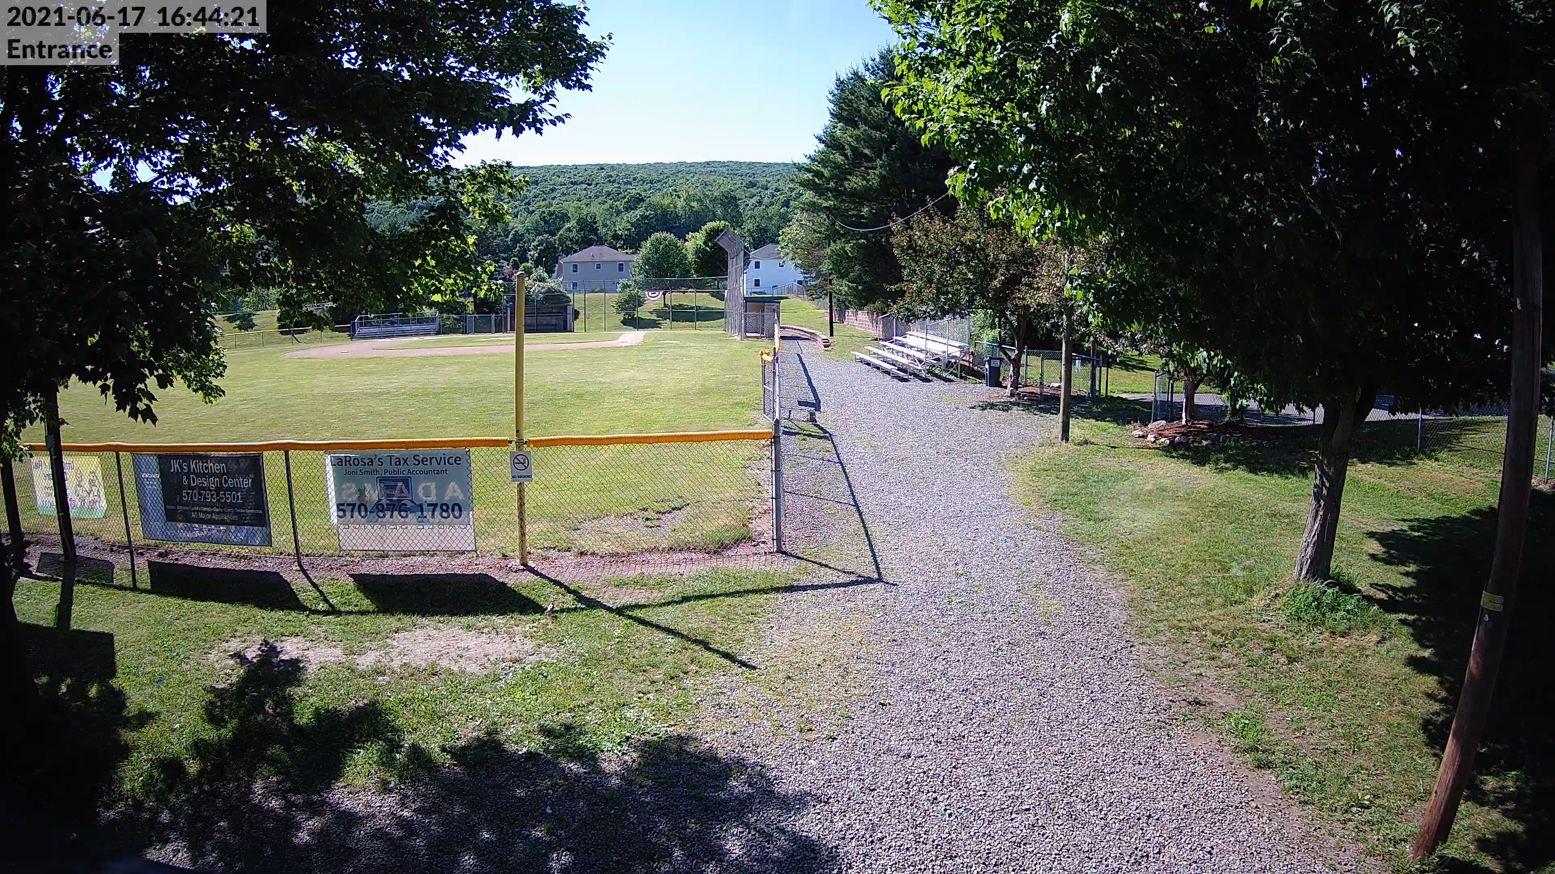

Slide 8
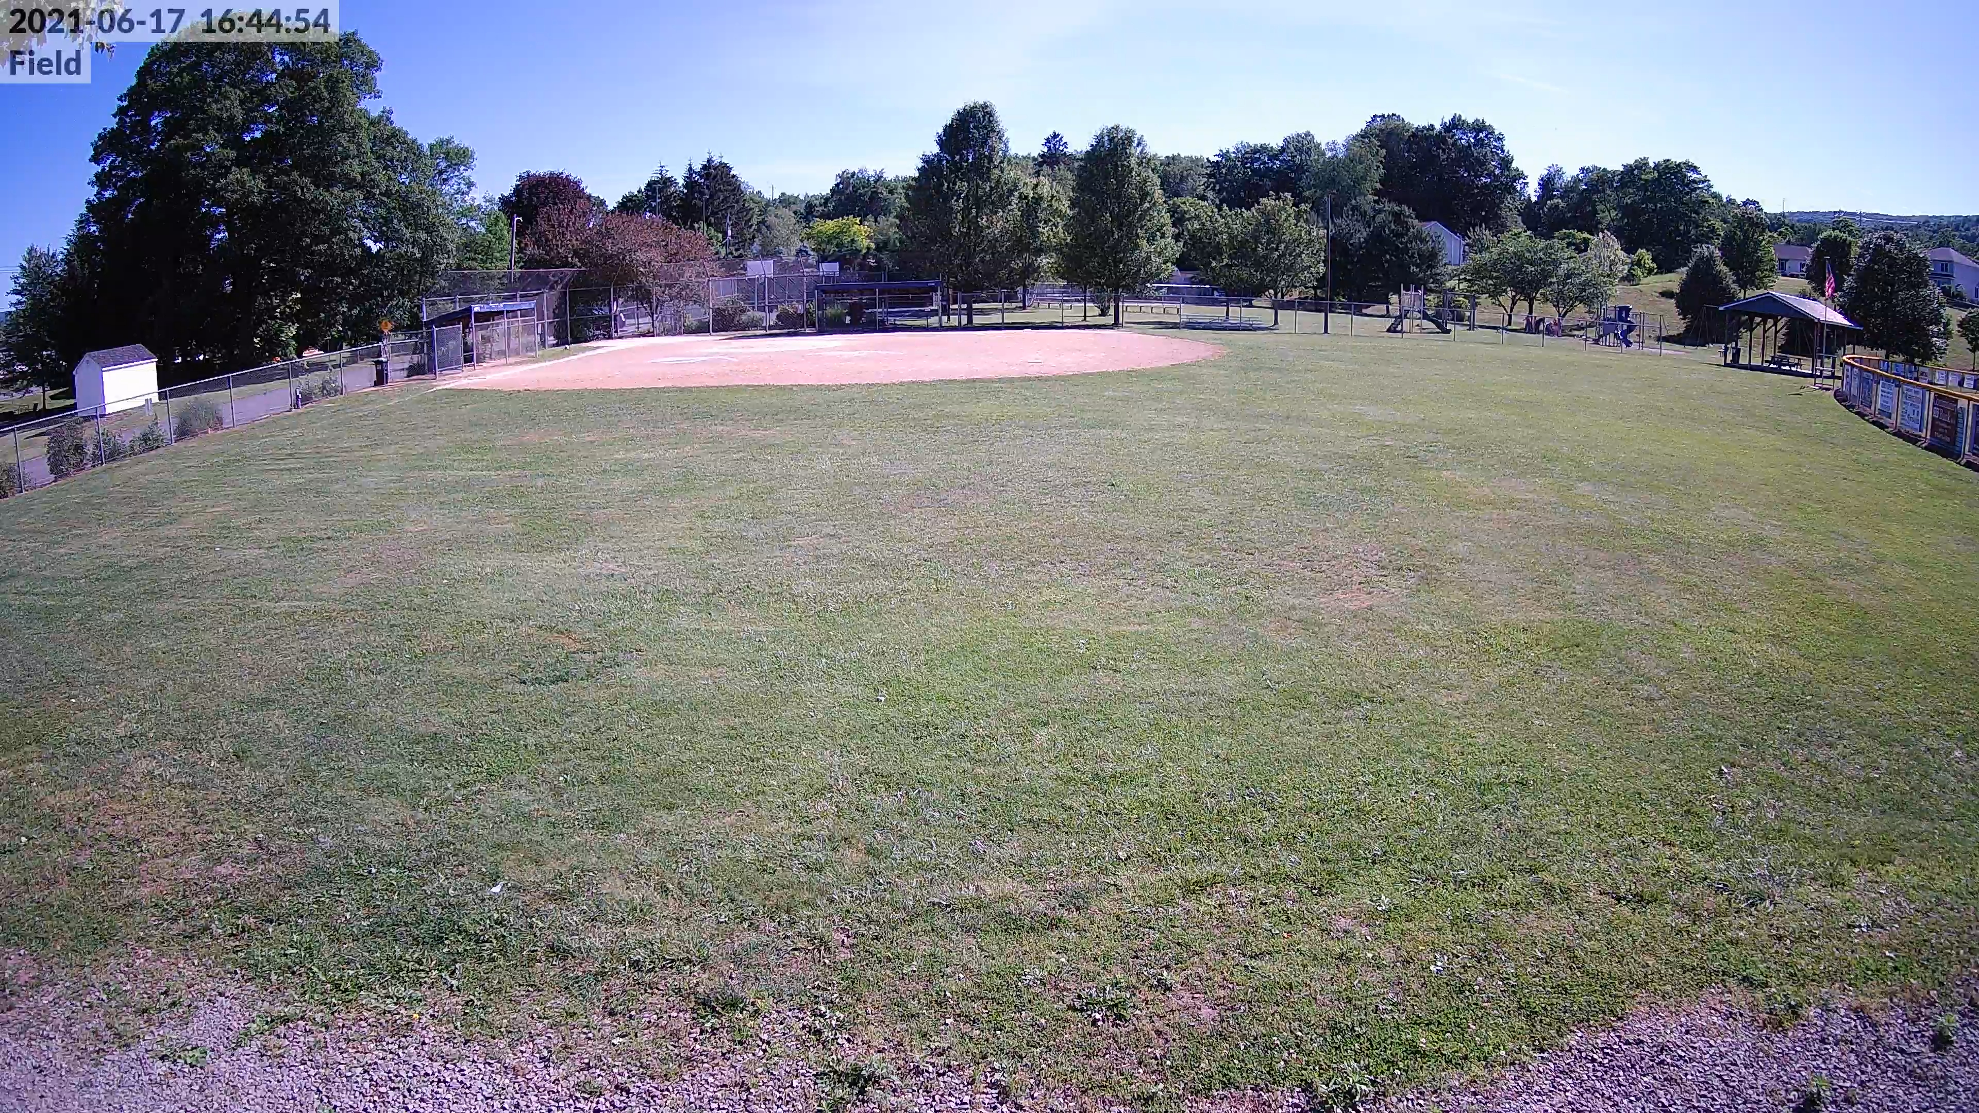

Slide 9
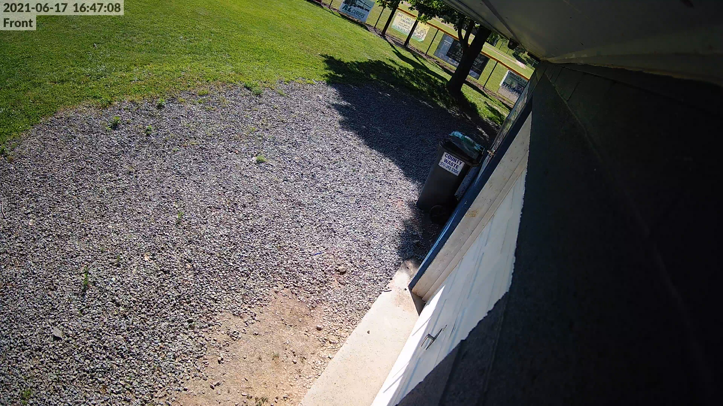

Slide 10
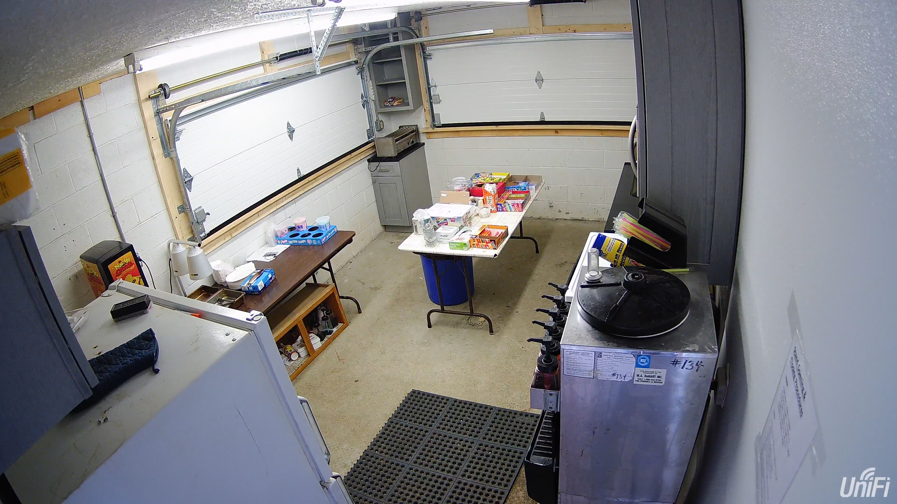

Slide 11
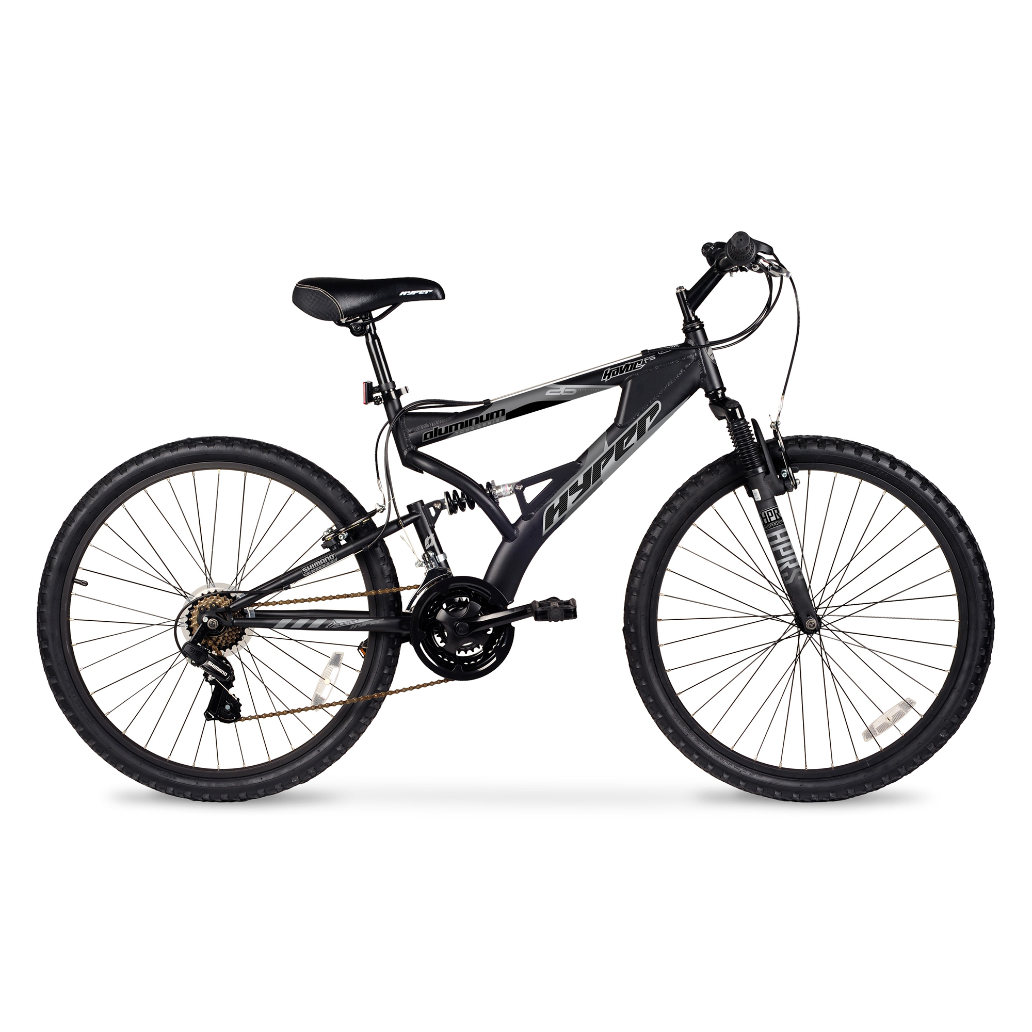

Slide 12
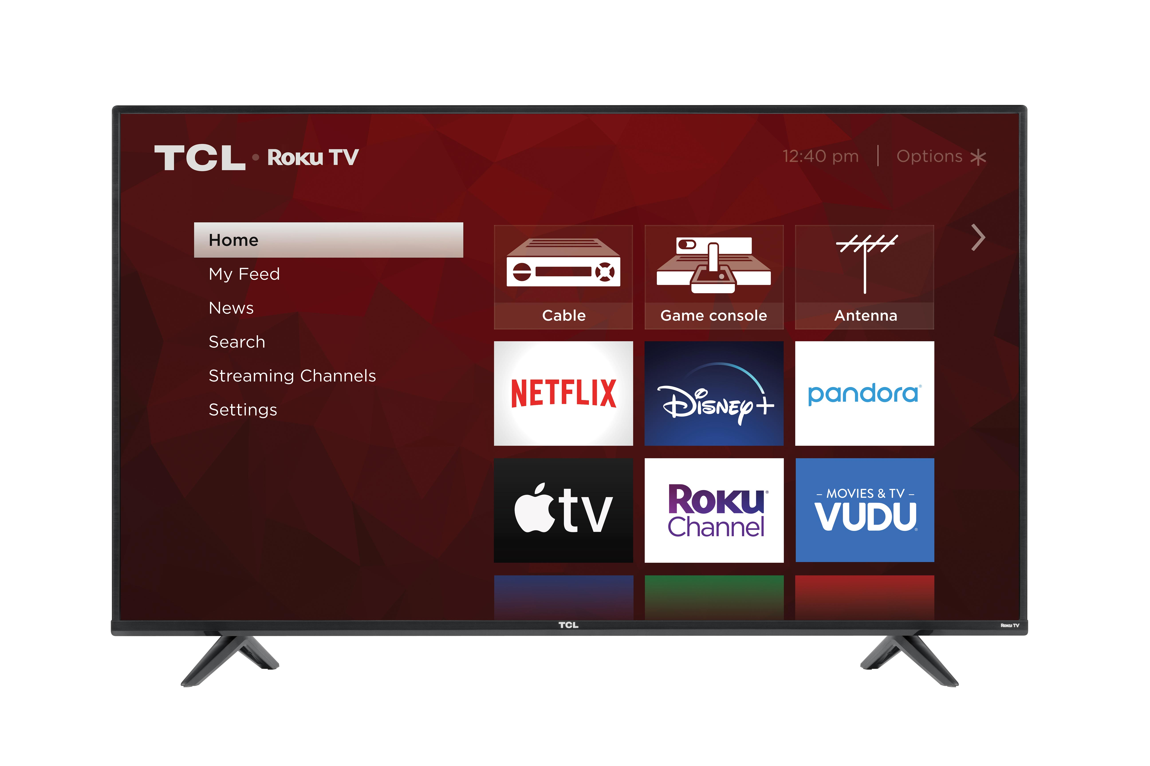

Slide 13
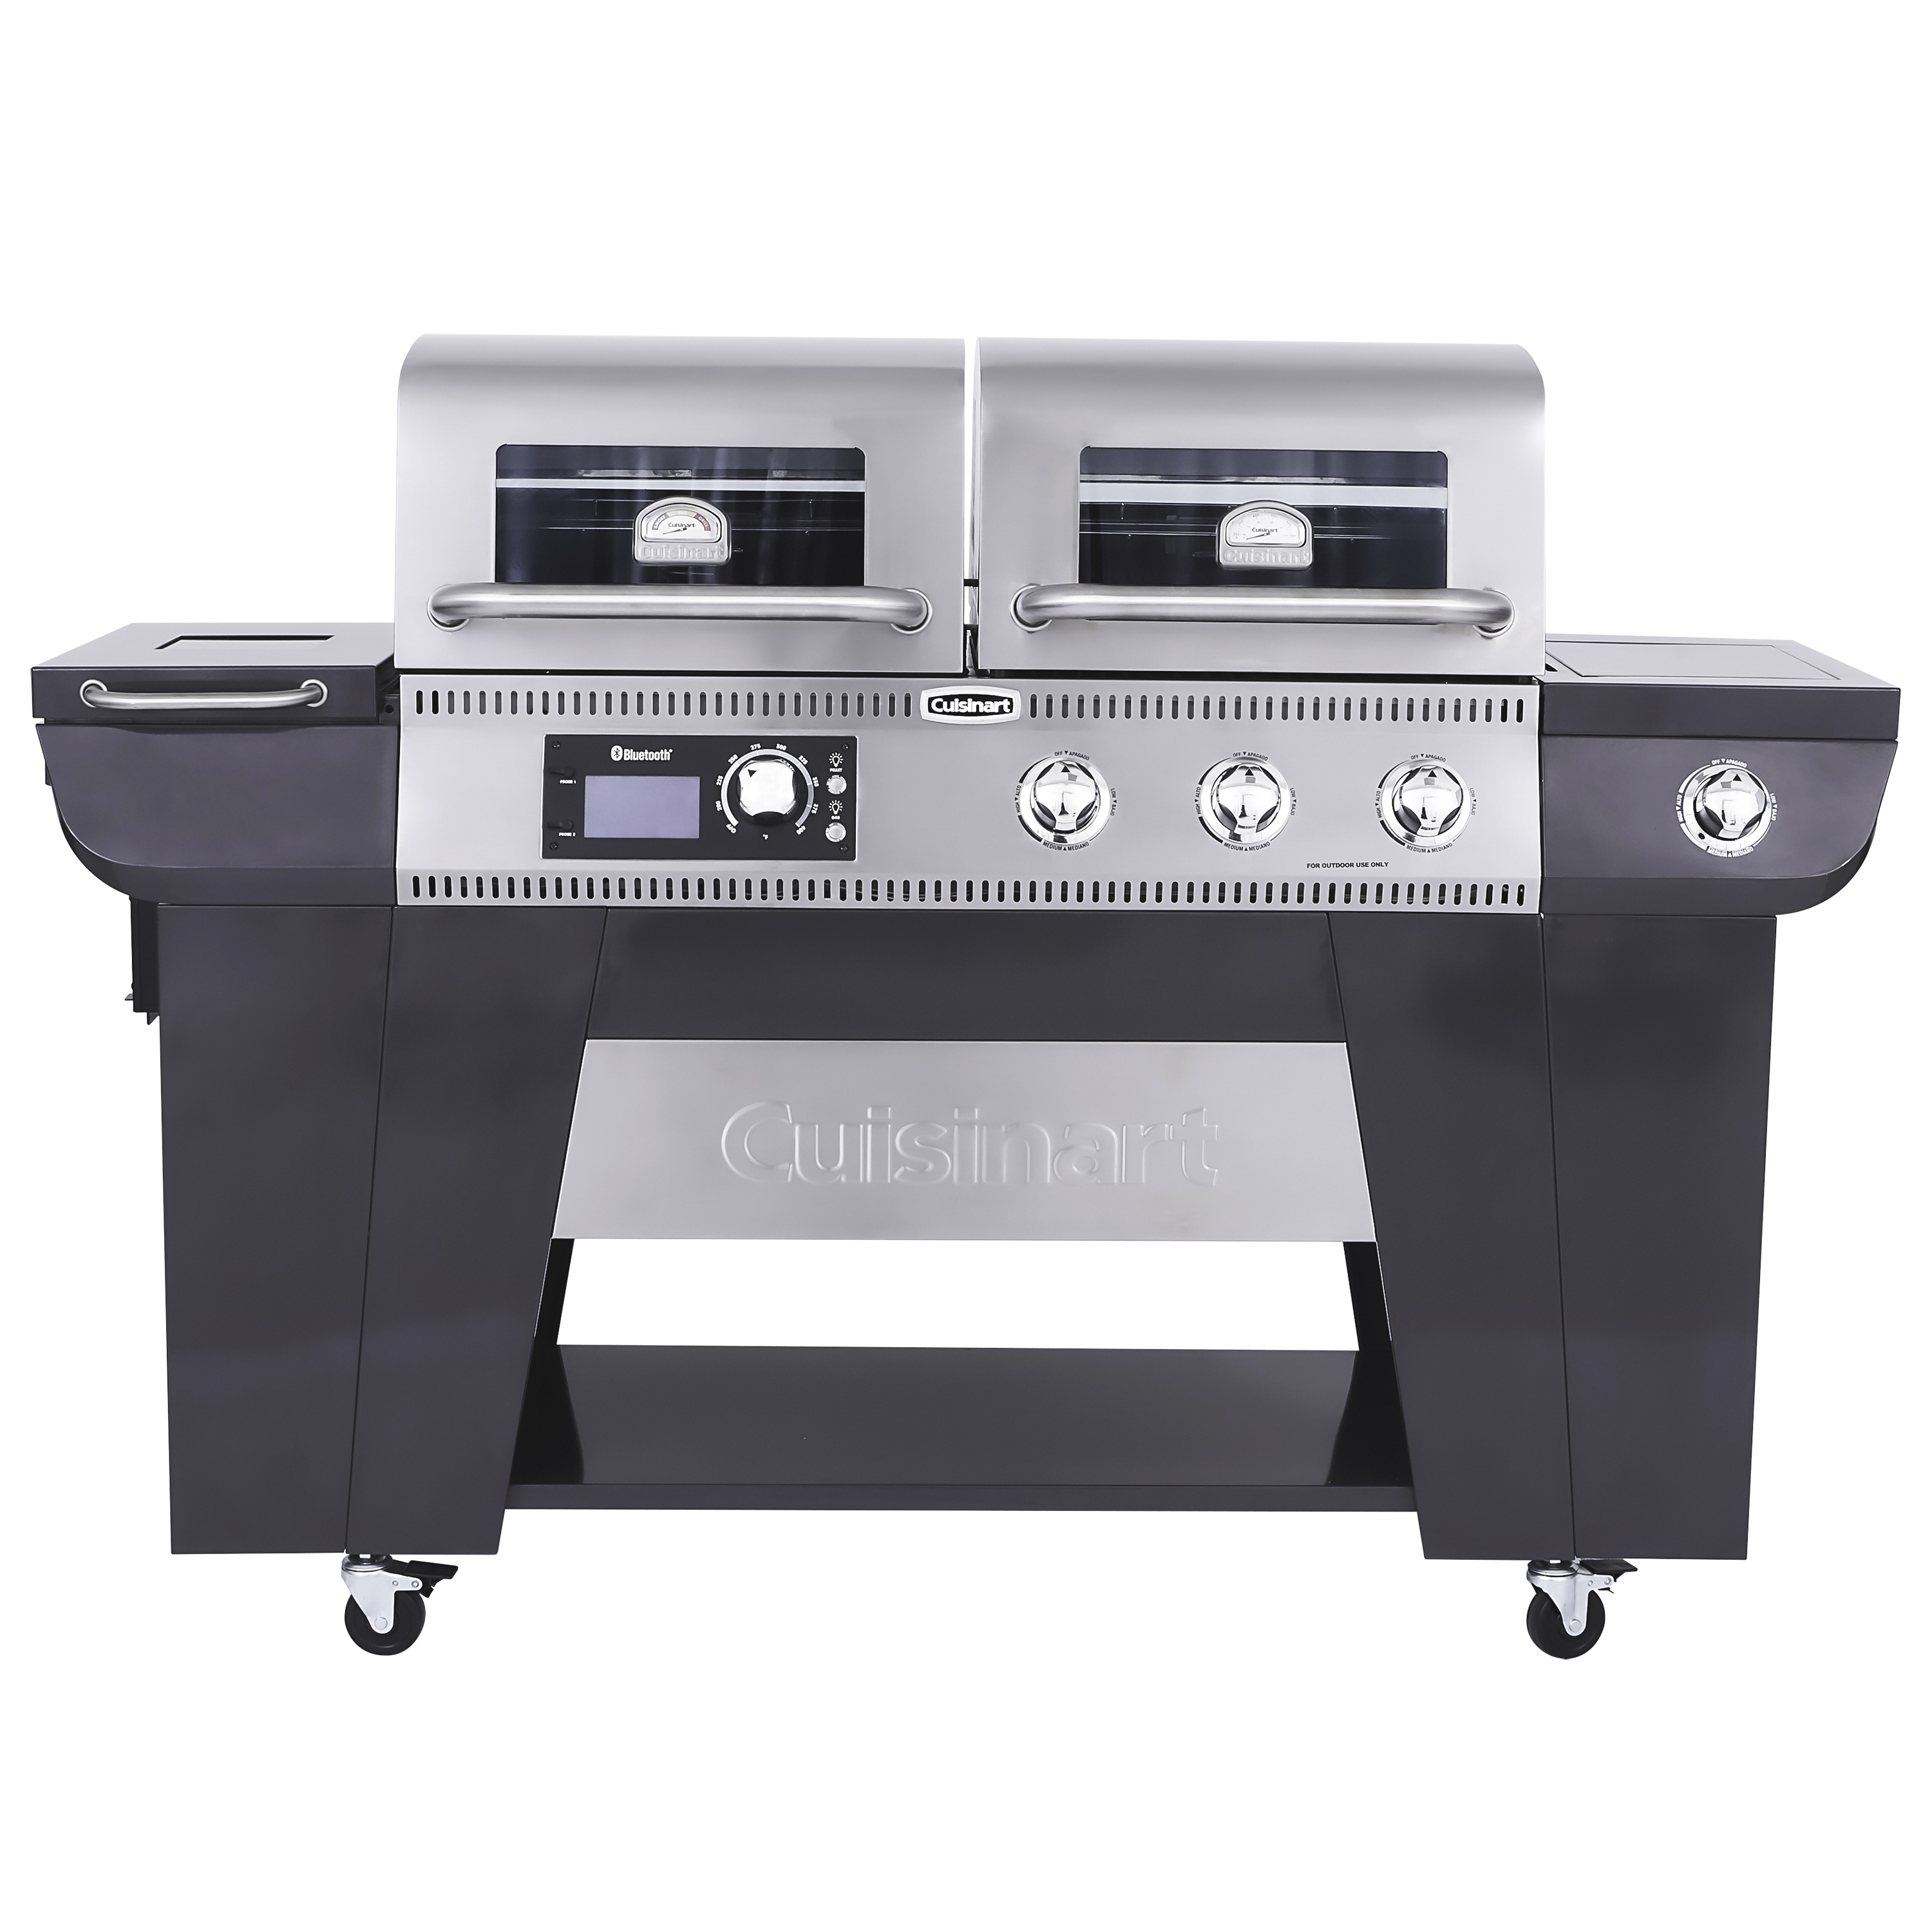

Slide 14


